Slide 1
DELHI RESTAURANTS ANALYSIS
PREPARED FOR
JAYPEE VASANTCONTINENTAL
OGBUROGHO BLESSING- DATA ANALYST | MARCH 28, 2024

Slide 2
DELHI RESTAURANTS DATA STRUCTURE
POINT
SCALE
Measured using a 5 point rating scale.
CODING
ITEMS
4 demographic coding items including:
Region, size (max seats, min seats)

Slide 3
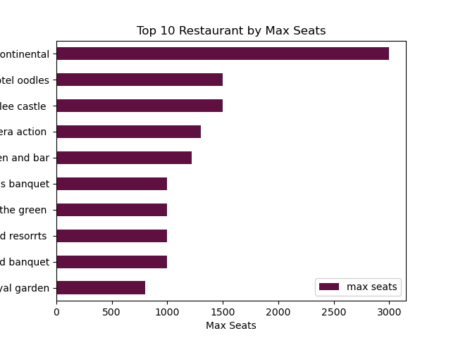

Slide 4
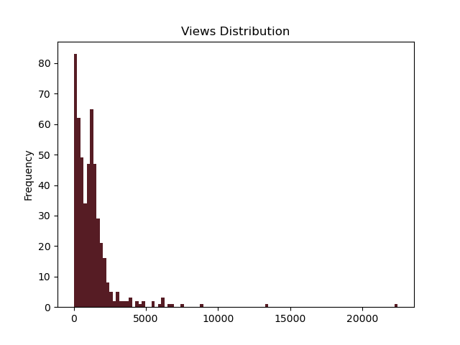

Slide 5
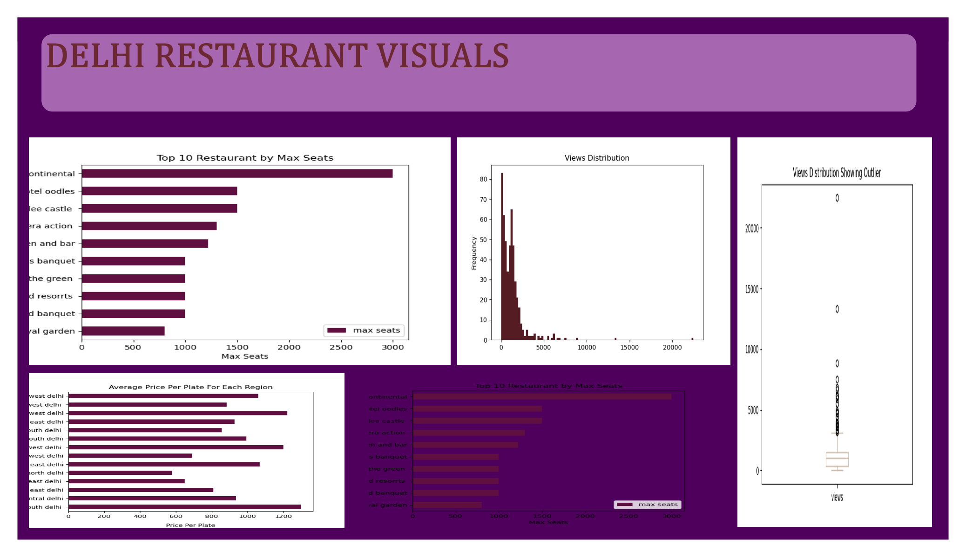

Slide 6
THANK YOU!!!

